Slide 1

Introduction to Artificial Intelligence and Its Applications in Social Security Funds
Dr Michael S. Mollel (PhD)
Co-Founder & CEO Sartify LLC

Slide 2
Overview of the Presentation
Introduction to AI
Introduction to Artificial Intelligence (AI)
AI in Social Security Funds
Key AI Technologies
AI Applications and Future
Use Cases in Social Funds
Benefits and Challenges
Future Directions
Notes:
Slide 2: Welcome and Opening Remarks
A very warm welcome to all of you present here today for this insightful presentation on "Artificial Intelligence and Its Applications: Shaping the Future of Technology in Tanzania."
It is my honor to have the opportunity to discuss this highly relevant and transformative field that holds immense potential for driving technological advancements and economic growth in our nation.
Artificial Intelligence, or AI, has rapidly evolved from a theoretical concept to a powerful technology that is reshaping industries, businesses, and our daily lives.
In this presentation, we will explore the fundamentals of AI, its current applications across various domains, and its potential impact on Tanzania's technological landscape.
We will delve into the opportunities and challenges presented by AI, and how we, as a nation, can harness its capabilities to drive innovation, efficiency, and sustainable development.
By understanding the capabilities and implications of AI, we can better prepare ourselves to embrace this disruptive technology and position Tanzania as a leader in the digital revolution.
I encourage you all to engage actively throughout the presentation, as your insights and perspectives will contribute to a deeper understanding of this fascinating topic.

Slide 3
Introduction

Slide 4

About Sartify
Co-Founder & CE0
Dr Michael Mollel, Co-Founder and CEO of Sartify LLC, has PhD in Information Communication Science and Engineering from NM-AIST & UOG. Experience in AI, ML, and 5G wireless communications. Senior Researcher at the University of Glasgow. Received multiple awards - PhD Research Award from NM-AIST (2020), IEEE WCNC Best Paper Award (2019), and the best AI Use Case ITU Geneva (2024). Email: michael.mollel@sartify.com

Slide 5
About Sartify
About Sartify LLC
A deep AI technology company specializing in consultation, research, and AI-powered products
Delivers customized AI decision-making solutions for enterprises and consumers
Helps clients enhance customer experience, increase efficiency, reduce costs, boost revenue, and drive exponential growth
Offerings
Custom ML/AI Engineering (Computer Vision, NLP, Recommender Systems, etc.)
Advanced Data Analytics (Business Insights, Predictive Modeling, BI Dashboards)
Data & AI Strategy Consultation (Data Governance, AI Roadmap, Change Management)
AI Executive Training (Workshops, Business Opportunities, Talent Acquisition)

Slide 6
About Sartify
Some of our works
Resume Parsing & Jobs Recommendations - Niajiri Platform Limited.
Customer’s Assistant ChatBot - AwamuPay.
Semantic Powered Search Feature & Products List Personalization - Biashara Plus Limited.
Some on progress works
Docipro: Intelligent Document Processing Autopilot.
Fotopic: AI-powered photographic App.
Resuma Platform: Brainstorm, Craft Profesional CV
Some of Research
Open Source various Swahili AI systems
AviLaMa: African Vision-Languages Pre-Training Model.
Swahili AI Evaluation Benchmark Platform.
African Languages Datasets to power various AI research & development in Africa.
Reach Us
www.sartify.com
https://www.sartify.com/contact-us
info@sartify.com
Notes:
Enterprise Custom Solutions:
Resume Parsing & Jobs Recommendations, Niajiri Platform Limited.
Customer’s Assistant ChatBot, AwamuPay.
iPFGPT - RAG Based System For iPF Softwares, iPF SOftwares.
Semantic Powered Search Feature & Products List Personalization, Biashara Plus Limited.
Research:
Open Source various Fine-tuned LLM for Swahili Language Example. Swahili Gemma, Llama, Mixtral etc.
AviLaMa : African Vision-Languages Pre-Training Model. [Learn Visual Concepts Directly From African Language Supervision, A work towards zero shot image retrieval and ranking tasks, zero image classification, visual QA & Conversational AI, Art & Image generation guiding & condition task, text image analysis and content moderation all done in our African Languages. ]
African Languages Datasets to power various LLM research & development in Africa.
A Cassava Categorization Way (Detection & Classification) with AI.
Swahili LLM Evaluation Benchmark Platform.
Our Current In-House Developing Products: Welcome to Join a Waitlist.
Docipro : Intelligent Document Processing Autopilot, a way to uncover valuable insights effortless from any unstructured data within complex manual business workflow- Powered by AI.
Fotopic : AI-powered photographic App. Instantly get quality photographic pictures for your single phone-taken photo. This cover different variations, lookings environment, clothes etc…
Resuma Platfrom : Brainstorm, Craft Profesional CV & Get your desired Job Instantly, all powered by AI (Docipro & Conversional AI).

Slide 7
Understanding Artificial Intelligence

Slide 8

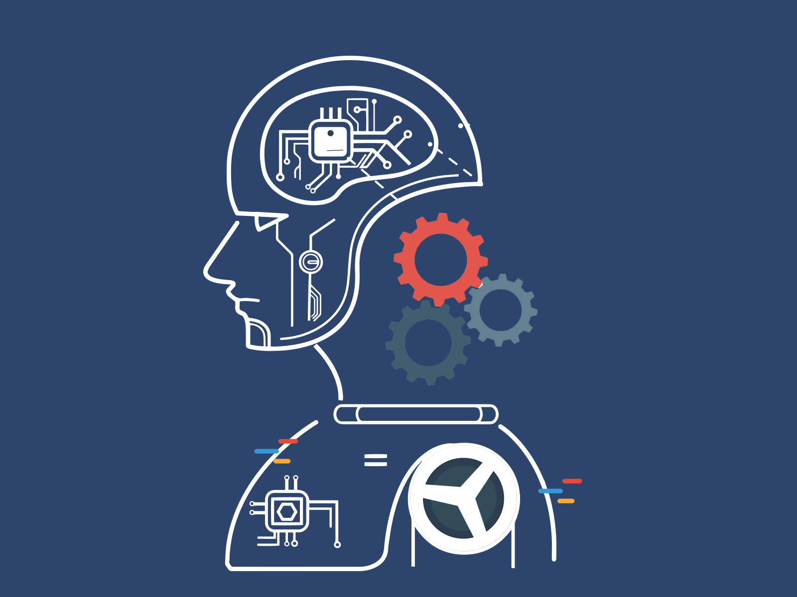
Definition and Basic Concepts
AI refers to the simulation of human intelligence processes by machines, particularly computer systems.
It involves developing systems that can perform tasks that typically require human intelligence, such as reasoning, learning, problem-solving, perception, and decision-making.

Slide 9
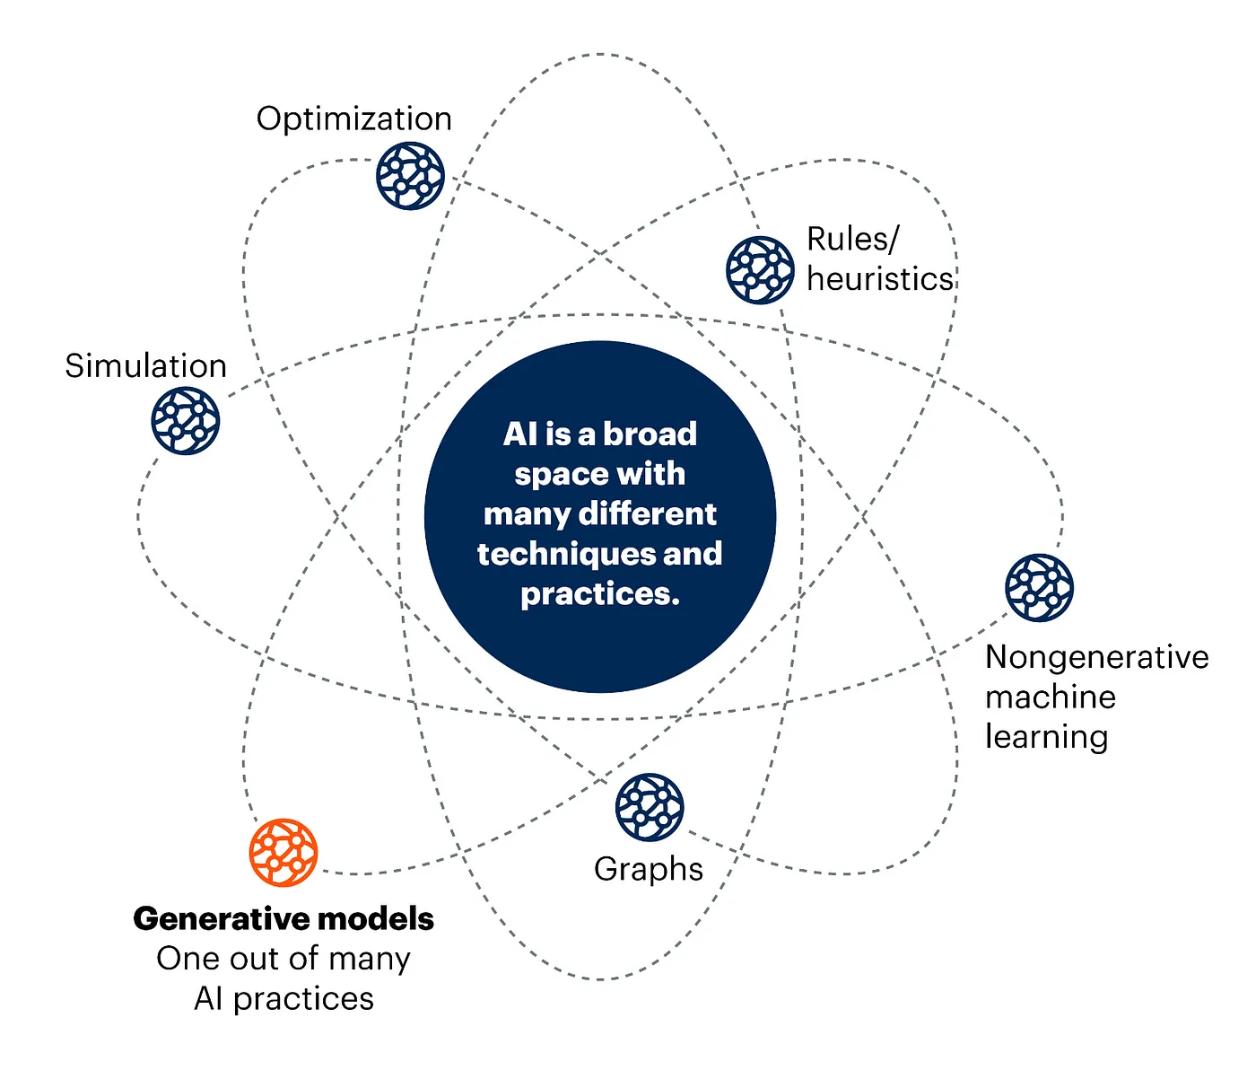
Definition and Basic Concepts

Slide 10
Key AI Technologies

Slide 11


AI can Do
Reinforcement Learning: AI agents learn to make decisions by interacting with an environment. Successes in game-playing (e.g., AlphaGo, AlphaFold) and robotics control.
Computer Vision: AI systems that accurately identify and analyze visual data. Tasks (object detection, facial recognition, medical imaging, etc.)

Slide 12
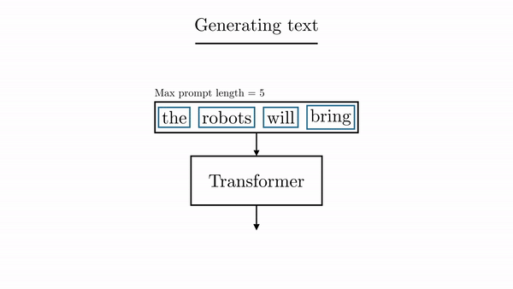
AI can Do
Large Language Models (LLMs): Massive neural networks trained on vast textual data (e.g., GPTs, BERT, LaMDA, Claude). Capable of generating human-like text, answering questions, and understanding natural language
Generative AI: AI models that can create new content, such as images, videos, music, and code( e.g., DALL-E, Stable Diffusion, Midjourney (image generation), Mubert (music generation)

Slide 13
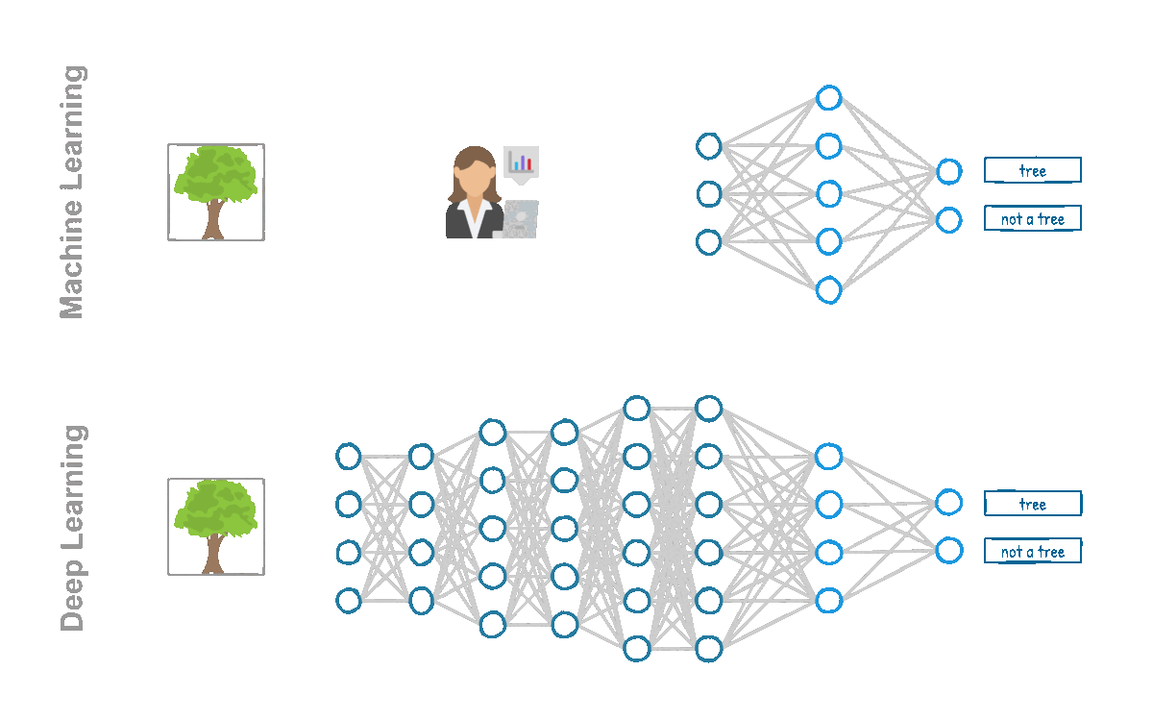
AI can Do
Deep Learning: A sophisticated form of Machine Learning inspired by the human brain's neural networks. Uses multi-layered artificial neural networks to learn from vast amounts of data. Excels in tasks like image and speech recognition and natural language processing.

Slide 14
How AI Works

Slide 15


How AI Works
Data: They can be structured (databases) or unstructured (images, text, audio). AI systems rely heavily on data for training and decision-making. Quality and quantity of data are crucial for effective AI models.
Algorithms: are the mathematical models and rules that drive AI systems. Algorithms learn from data and make predictions or decisions.
Notes:
Data AI systems rely heavily on data for training and decision-making.
Data can be structured (databases) or unstructured (images, text, audio).
Quality and quantity of data are crucial for effective AI models Algorithms Algorithms are the mathematical models and rules that drive AI systems.
Common algorithms include decision trees, neural networks, and deep learning models.
Algorithms learn from data and make predictions or decisions.

Slide 16
How AI Works
Data Processing:
preprocessed and transformed into a format suitable for AI algorithms.
Techniques include data cleaning, normalization, feature extraction, and dimensionality reduction.
Remove noise, handle missing values, and extract meaningful patterns from the data.
Model Training:
Once the data is processed, it trains AI models using machine learning algorithms.
AI model learns to identify patterns and relationships within the data.
Different algorithms, such as supervised, unsupervised, or reinforcement learning, may be employed depending on the problem and available data.
Notes:
Data AI systems rely heavily on data for training and decision-making.
Data can be structured (databases) or unstructured (images, text, audio).
Quality and quantity of data are crucial for effective AI models Algorithms Algorithms are the mathematical models and rules that drive AI systems.
Common algorithms include decision trees, neural networks, and deep learning models.
Algorithms learn from data and make predictions or decisions.
Computing Power AI systems, especially deep learning models, require significant computational resources.
High-performance CPUs, GPUs, and specialized hardware accelerate training and inference.
Cloud computing and distributed systems enable access to vast computing power.
Software Tools AI development relies on various software tools and frameworks.
Examples include TensorFlow, PyTorch, Scikit-Learn, Keras, and more.
These tools simplify the development, training, and deployment of AI models.

Slide 17
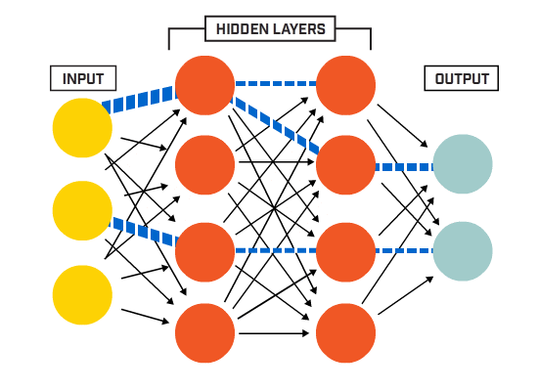
How AI Works
Prediction and Decision Making
AI model can be deployed to make predictions or decisions on new, unseen data.
The model applies the learned patterns and relationships to the new data, generating outputs or recommendations.
Outputs can be used for fraud detection, predictive analytics, or automated decision-making processes.
Continuous monitoring and evaluation of the model's performance to ensure accuracy and reliability.

Slide 18
AI vs NO AI Framework
Each Augmentation or Automation decision requires a Desirability, Viability & Feasibility Assessment
Notes:
Each Augmentation or Automation decision requires a Desirability, Viability & Feasibility Assessment

Slide 19
AI in Social Security Funds

Slide 20
Overview of WCF
Overview of Workers Compensation Fund (WCF)
Workers Compensation Fund (WCF) provides financial compensation and support for employees who suffer from occupational injuries, diseases, or death arising from their employment.
WCF operates in mainland Tanzania, catering to public and private sector employees.
The fund ensures adequate and equitable compensation to affected employees or their dependents.
Some potential problems or fraudulent activities:
False claims, 2) Employer misrepresentation, 3) Medical provider fraud, 4) Identity theft, 5) Collusion and kickbacks, 6) Document forgery, 7) Double-dipping, 8) Ghost beneficiaries
Notes:
False claims: Employees or their dependents may submit fraudulent claims for injuries or illnesses that did not occur during employment or exaggerate the severity of legitimate claims to receive higher compensation.
Employer misrepresentation: Employers may misrepresent the nature of an employee's work or underreport the number of employees who pay lower contributions to the WCF, depriving the fund of rightful revenues.
Medical provider fraud: Medical professionals or healthcare facilities may engage in fraudulent practices, such as billing for services not rendered, overstating the extent of injuries, or providing unnecessary treatments to inflate claims against the WCF.
Identity theft: Fraudsters may use stolen identities to file false claims or obtain benefits intended for legitimate claimants.
Collusion and kickbacks: There could be collusion between employees, employers, medical providers, or even WCF staff members, involving kickbacks or other forms of bribery to facilitate fraudulent claims or payments.
Document forgery: Fraudulent documents, such as fabricated medical reports or employment records, may be submitted to support false claims or misrepresent eligibility for benefits.
Double-dipping: Claimants may attempt to receive compensation from multiple sources (e.g., private insurance and other government programs) for the same injury or illness, leading to overpayments or duplicate claims.
Ghost beneficiaries: Fraudsters may continue to receive benefits intended for deceased individuals by failing to report their deaths to the WCF.

Slide 21
Importance of AI in enhancing WCF systems
Efficient Registration and Risk Assessment
AI technologies can streamline the registration of employers and employees, ensuring comprehensive coverage.
AI can enhance the assessment of risk exposure at workplaces by analyzing large data sets to identify high-risk areas and predict potential hazards.
Improved Collection and Management of Contributions
AI can automate the collection of contributions from employers, reducing administrative burdens and minimizing errors.
AI systems can effectively manage and invest surplus funds, optimizing returns and ensuring financial stability for the fund.

Slide 22
Importance of AI in enhancing WCF systems
Enhanced Compensation Processes
Speed up compensation claims processing, ensuring timely and accurate payments to employees or their dependents.
Analyze claims data to detect patterns and prevent fraudulent activities.
Future Directions
Predictive analytics to foresee occupational health and safety trends.
Integrating AI with IoT devices for real-time monitoring of workplace conditions and immediate response to potential hazards.
Data Management and Analytics
AI can maintain and analyze statistics on occupational accidents, diseases, and deaths, providing insights for preventive measures.
AI-driven analytics can inform public education and awareness programs, promoting workplace safety.

Slide 23
Specific Use Case

Slide 24
Use Case 1: Fraud Detection
Identifying Fraudulent Claims
Leverage machine learning algorithms to detect anomalies.
Analyze transaction patterns to identify suspicious behavior.
Implement real-time monitoring systems to flag potential fraud.
Reference: Link
Reducing Fraudulent Activities
Employ predictive analytics to anticipate fraud trends.
Integrate fraud detection systems with existing business processes.
Use data visualization tools to understand better and mitigate risks.
Reference: Link

Slide 25
Use Case 2: Customer Service
AI-powered Chatbots and Virtual Assistants
Chatbots and virtual assistants to handle customer inquiries and provide personalized assistance.
Understand natural language queries, retrieve relevant database information, and provide accurate and consistent responses.
Chatbots and virtual assistants can be available 24/7, ensuring customers receive prompt support whenever needed.
Improved Response Times and Customer Satisfaction
Significantly reduce wait times for customers.
Ensure consistent and accurate responses.
Enhance customer satisfaction through quick and efficient service.

Slide 26
Use Case 3: Predictive Analytics
Forecasting Future Trends and Demands
By analyzing historical data and patterns, AI models can forecast future trends such as population demographics, economic conditions, and benefit claims.
Accurate forecasting enables WCF to anticipate future demands and plan resources accordingly, ensuring efficient service delivery.
Proactive Decision Making
WCF can make proactive decisions and implement strategies to address potential challenges or capitalize on opportunities.
Informed decisions related to resource allocation, benefit program design, policy development, and risk management.
By staying ahead of the curve, WCF can enhance its responsiveness and better serve the needs of beneficiaries.

Slide 27
Use Case 4: Automated Processing (Link)
Automating Repetitive Tasks
AI and robotic process automation (RPA) can automate repetitive and routine tasks within WCF operations.
Tasks such as data entry, document processing, and claim form verification can be automated using AI technologies, reducing the need for manual intervention.
Automation of repetitive tasks can minimize human errors, improve accuracy, and free up human resources for more complex and value-added activities.
Increasing Operational Efficiency
By automating repetitive and time-consuming tasks, WCF can significantly improve its operational efficiency.
Automated processes can handle a higher volume of work with consistent quality, leading to faster processing times and reduced backlogs.
Increased efficiency translates into cost savings and the ability to serve beneficiaries more effectively.

Slide 28
Benefits of AI in WCF
Enhanced efficiency
Cost savings
Improved accuracy
Better customer service
Fraud detection and prevention
Data-driven decision making
Personalized services
Scalability and adaptability

Slide 29
Challenges of Implementing AI
Data Privacy and Security
AI systems in WCF would rely on large amounts of personal and sensitive data. Concerns about data privacy and security.
Robust measures must be implemented to protect beneficiaries' data and prevent unauthorized access or misuse.
Compliance with data protection regulations and industry standards is crucial when deploying AI solutions.
Integration with Existing Systems
Integrating AI technologies with legacy systems and processes can be challenging, requiring careful planning and execution.
Compatibility issues, data formatting, and system interoperability must be addressed to ensure seamless integration and avoid disruptions.
Change management strategies are essential to facilitate the adoption of AI solutions within established organizational workflows.

Slide 30
Challenges of Implementing AI
Ethical Considerations
Bias, transparency, and accountability.
AI systems must be designed and trained to be fair, unbiased, and accessible from discriminatory practices.
Ethical frameworks and guidelines must be established to ensure responsible and trustworthy AI implementation.
Need for Skilled Personnel
Implementing and maintaining AI solutions requires a skilled workforce with data science, machine learning, and AI engineering expertise.
Challenges in attracting and retaining talent in these highly specialized fields.
Continuous training and upskilling of existing personnel are necessary to build and sustain AI capabilities within the organization.

Slide 31
Future Directions
Emerging AI Trends
Advancements in NLP, computer vision, and reinforcement learning are expected to enhance AI capabilities further.
The development of explainable AI systems can provide transparent and interpretable decision-making processes.
The integration of AI with other emerging technologies, such as the Internet of Things (IoT) and blockchain, could enable new applications and use cases.
Future Potential Applications
AI could be leveraged for personalized benefit recommendations based on individual circumstances and preferences.
Predictive analytics could be expanded to forecast long-term societal trends, inform policy decisions, and ensure the sustainability of WCF systems.
Virtual agents could provide personalized guidance and support to beneficiaries throughout the application and claims processes.

Slide 32
Preparing for AI Advancements
Preparing for AI Advancements
WCF should invest in building a robust data infrastructure and ensuring data quality to support future AI initiatives.
Developing an AI strategy aligned with organizational goals and ethical principles is crucial for successful AI adoption.
Continuous training and upskilling of personnel and collaboration with academic and research institutions can help organizations stay ahead of AI advancements.
Fostering a culture of innovation and embracing emerging technologies will be essential for social security funds to leverage the full potential of AI in the future.

Slide 33

Q&A Session

